Slide 1
CLASSIFIED
Classified is Jordi Beernink, Thijs Werrij, Roel Bouman, Jeffrey Luppes, and Gerdriaan Mulder.
Sberbank Russian Housing Market Competition
https://www.kaggle.com/c/sberbank-russian-housing-market

Slide 2
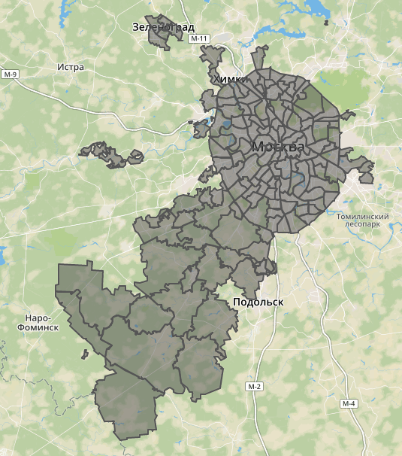
Sberbank Russian Housing Market
Kaggle Competition ending June 29
Data from the Russian Property Market
Spatial element: different areas of Moscow
Time: Data is from 2011 to 2015. But the test set is from 2015 to 2016!
Macro-economic data: information on Russia’s financial sector and macroeconomy
To predict: Price.
Large amount of features in data set already

Slide 3
Iets over data explo (mijn stuff, Jordi, thijs?)

Slide 4
Approach
Missing data: what can we do?
Implementing basic methods to see what we get: XGBoost

Slide 5
Results
Current rank:
.. Per model

Slide 6
From here onwards
Ensembles
More methods (DNN)
More data!

Slide 7
Closing statement (betere naam nodig)
Team Classified
Sberbank Housing Prices
Challenges: Data quality, test set different from train
Approach: Ensembles, exploring creative data enrichment
Current rank …/…

